Slide 1
Banking System
By: Lamar Sims, Cody Heard, Chris Jones , Kevin Clyne
Gary Sims

Slide 2
Banking system: Introduction
This project’s objective is to implement an application that carries out functions of a bank.
Allows user to log-in to personalized bank account
Ability to create bank accounts, deposit/withdraw funds.

Slide 3
UP
Many ideas are being tossed back and forth. Ex. Library or School
April 2nd - Banking system decided was the final decision on the project
April 7th - Starting of programming and what patterns would be used with the banking system.
April 9th - Continued programming with some major difficulties
April 14th- Completely restarting code, changing some patterns and starting from scratch.
April 21st - Code is finished, but major debugging, testing and GUI creation.
April 23rd - GUI is now partially programmed.
April 28th - GUI is finished and connected, but further testing shows issues caused by user input and logical problems.
April 29th - 9 hour spree of coding, testing, and debugging. The banking system is complete.
12 total classes with a total of 1933 lines of code.

Slide 4
Used Cases
Start-up Case – When the application is run the user will be prompted to create an account in order to access the banking interface.
Account Creation Case – The user will then reach a form that asks for the user’s name, age, SSN, address, password, bank, and the type of account he/she wishes to create(Savings/Checking). The information is then printed and displayed on the console.
Account Balance Input Case – The User will be asked to enter the balance for whichever account is selected. A pop-up message will then display all of the user’s account information.
Account Log-in Case – The user will user must then access the banking interface by returning to the start-up screen, and entering their access ID and password. A pop-up will ask the user to verify their password for a 2nd time.
Banking interface Case- Once logged in, the user will be able to view their account balance, account ID, and make withdrawals and deposits.

Slide 5
Used Cases cont.
Account Deposit Case – The user can make a deposit to their checking/savings account by clicking on the “Deposit” button, then entering the amount they wish to deposit. They will then see their updated account balance on the banking interface screen.
Account withdrawal Case – The user can make a withdrawal to their checking/savings account by clicking on the “withdrawal” button, then entering the amount they wish to withdraw. They will then see their updated account balance on the banking interface screen.
Invalid input Case – Any invalid characters will not be accepted, and the application will notify the user via pop-up message.

Slide 6
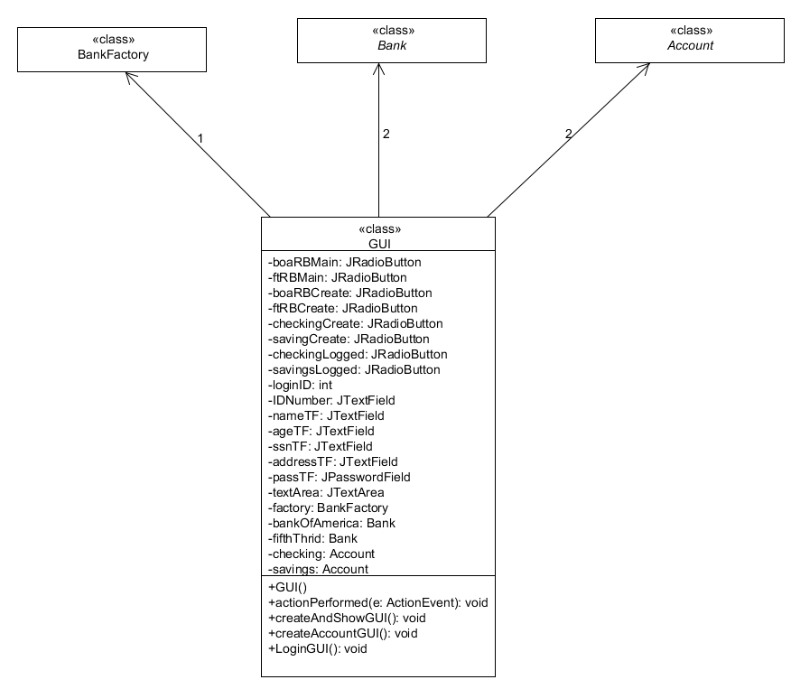
UML

Slide 7
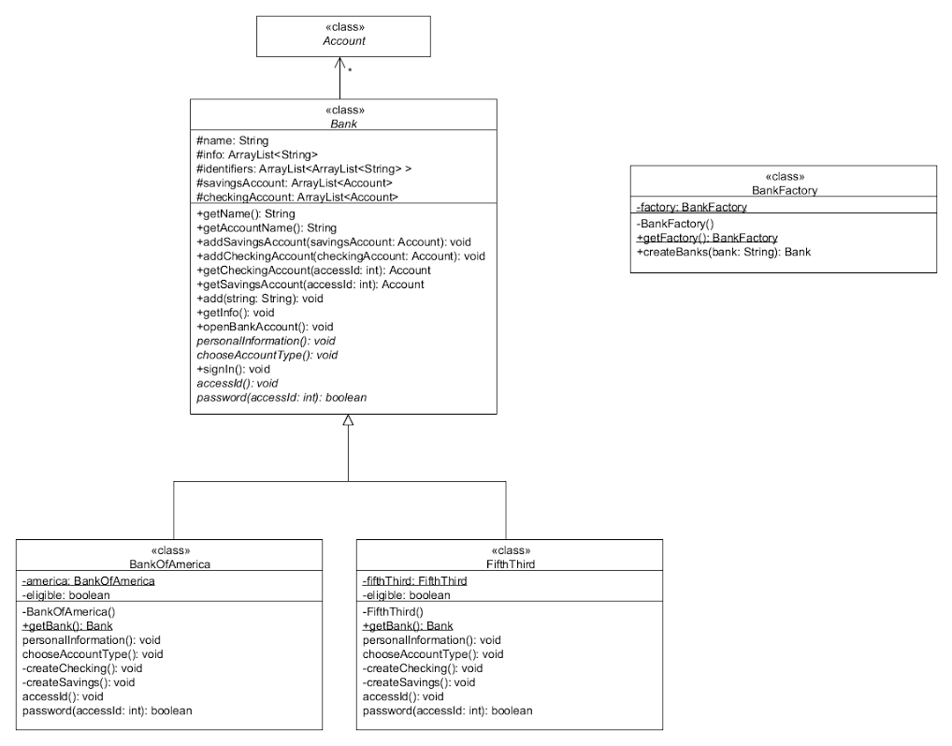
UML

Slide 8
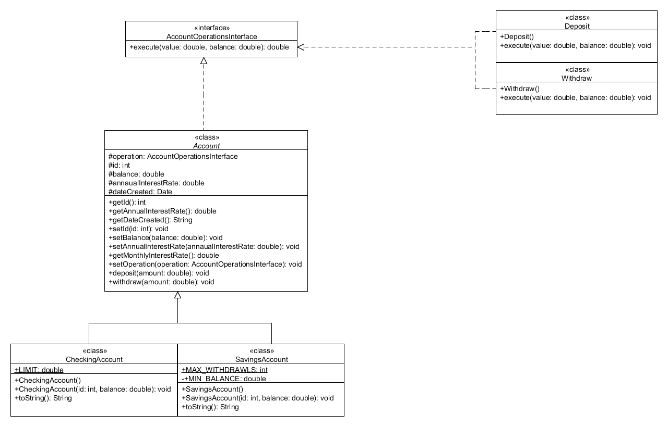
UML

Slide 9
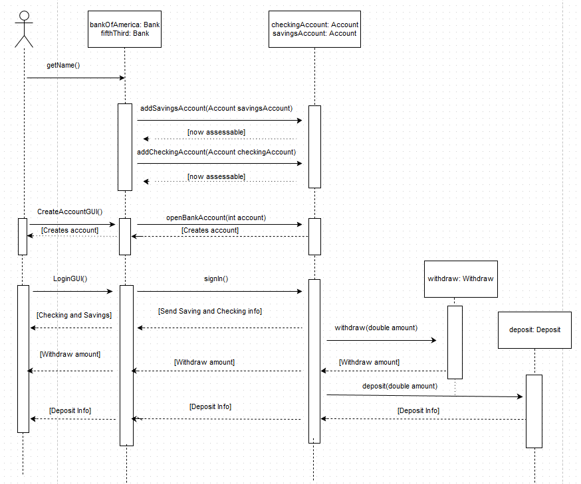
Sequence Diagram

Slide 10
Banking System: Patterns
Strategy – Was used to interchangeably perform the common banking operation. It allowed the operations to be changed at run-time. The banking operations used for the strategy pattern was the deposit operation and the withdraw operation; this allows the user to quickly deposit into their bank accounts and withdraw from their bank accounts.
Factory - Was used to create the instances of the banks. This allowed the banks to be created at run-time when needed allowing less coupling and dependency in the code.
Singleton – Was used to create a single instance of each of the banks, making sure each bank created was unique.
Template Method – Was used by the concrete banks classes to implement the algorithms for bank account creation and login. It allows the banks to implement their own specific account creation and login specifications, without changing the core algorithm for each.

Slide 11
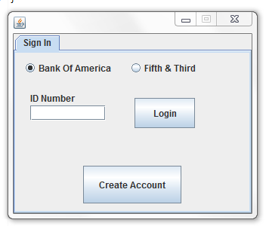
GUI
At the Start-up Screen, the user is prompted to create a new bank account.

Slide 12
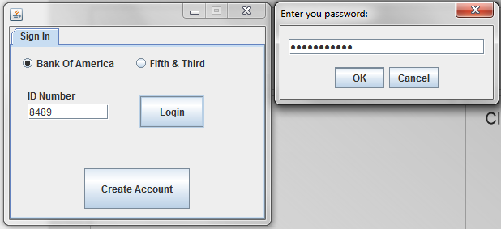
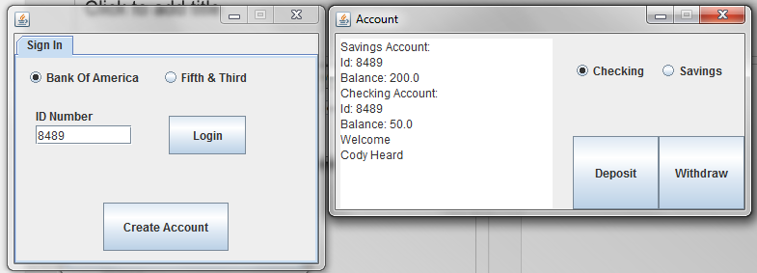
GUI Continued
The user is asked for the password connected to the access ID.
Once the user is in the window, they are giving the option to deposit or withdraw from their checking or savings.

Slide 13
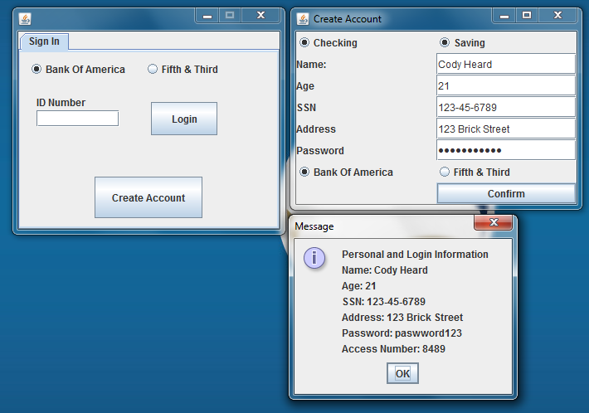
GUI Continued
After creating an account the user is supplied with some info and an access ID for the account.

Slide 14
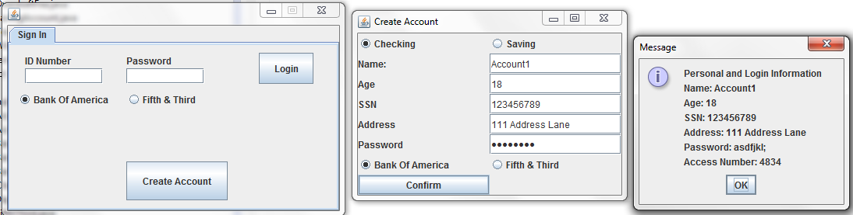
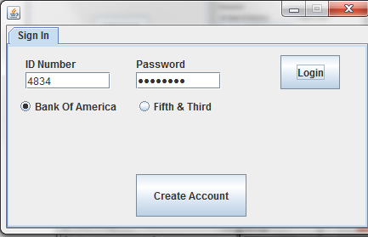
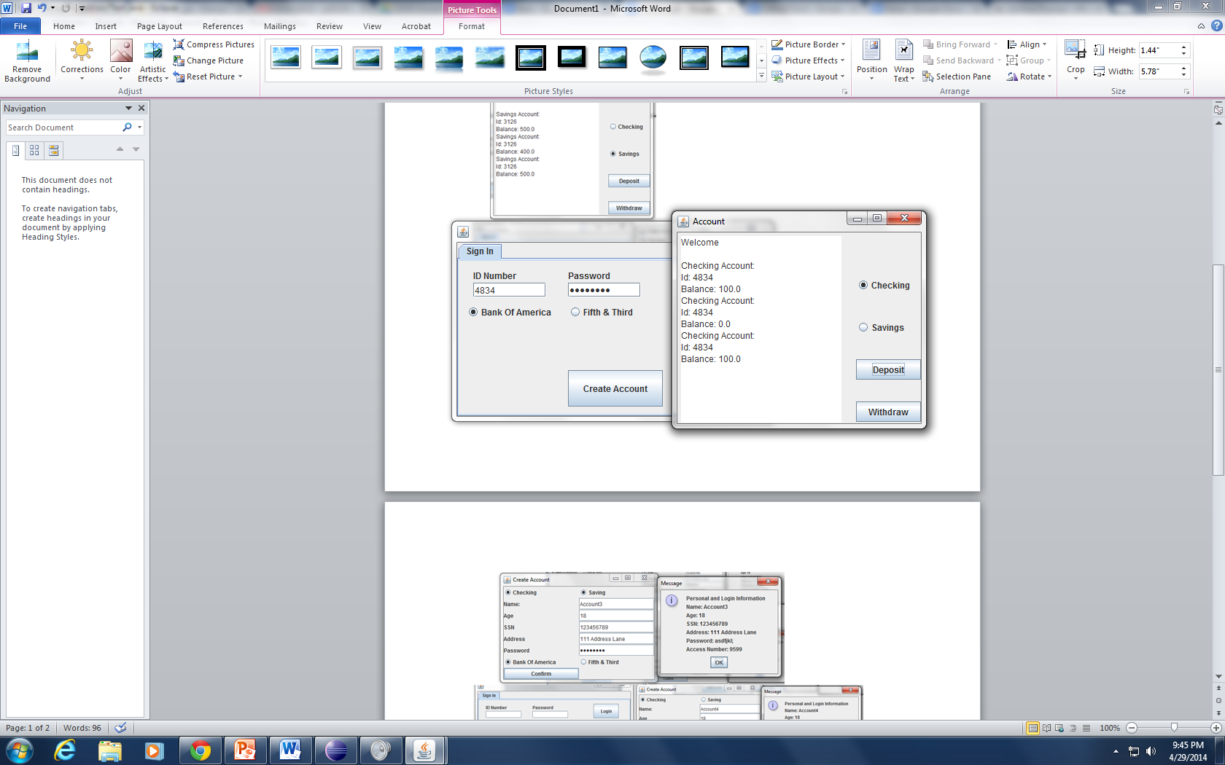
White Box Testing
Account 1 Bank of America Checking Creation
Login & Execution

Slide 15
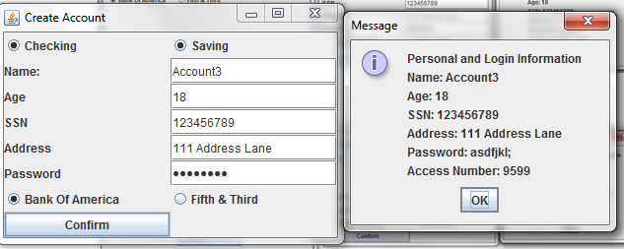
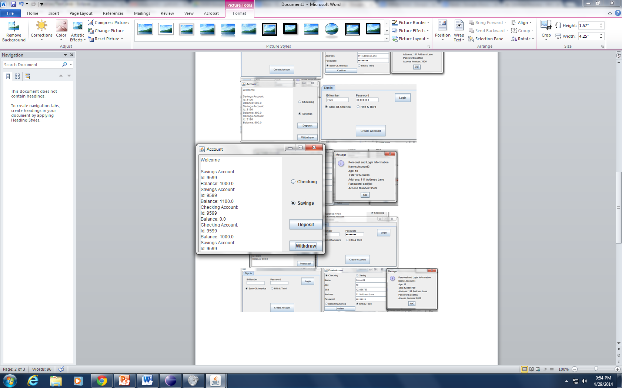
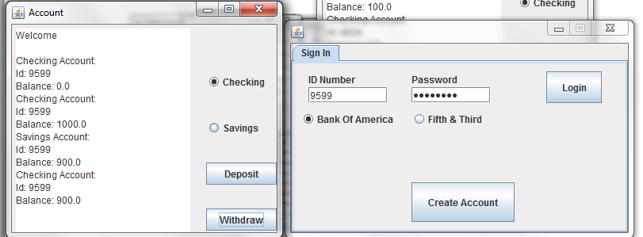
White Box Testing Cont
Account 3 Bank of America Checking and Savings Creation
Login & Execution

Slide 16
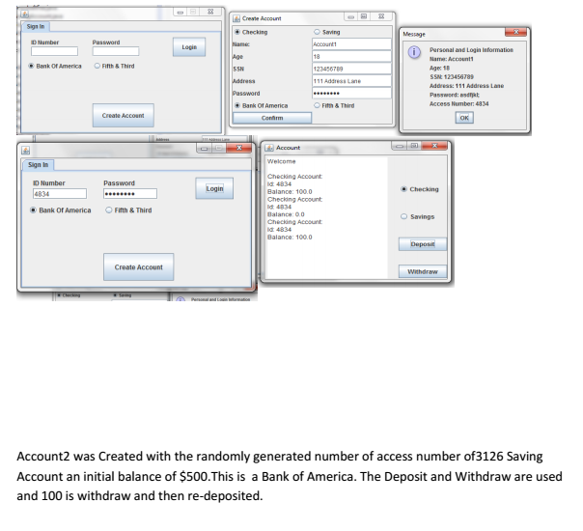
Black Box Testing

Slide 17
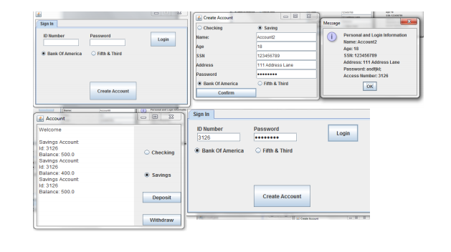
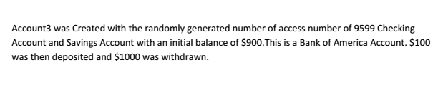
Black Box Testing Cont.

